Slide 1
Springboard Data Science Career Track
Unit 4 Challenge
Farid Javadnejad

Slide 2
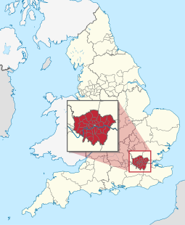
Introduction
In this case study, I performed the four stages of the Data Science Pipeline
Sourcing and loading
Cleaning, transforming, and visualizing
Modeling
Evaluating and concluding
The sample data included the housing prices for London boroughs

Slide 3
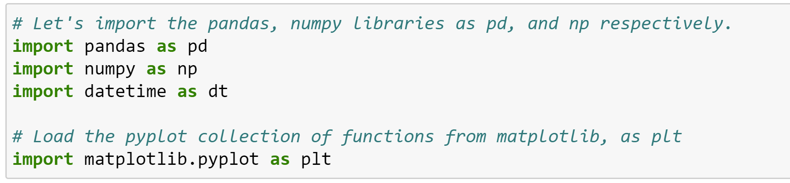
1. Sourcing and loading
1.1. Import necessary libraries
1.2. Loading the data
url_LondonHousePrices = "https://data.london.gov.uk/download/uk-house-price-index/70ac0766-8902-4eb5-aab5-01951aaed773/UK%20House%20price%20index.xls”
The dataset we're interested in contains the Average prices of the houses and is actually on a particular sheet of the Excel file.

Slide 4

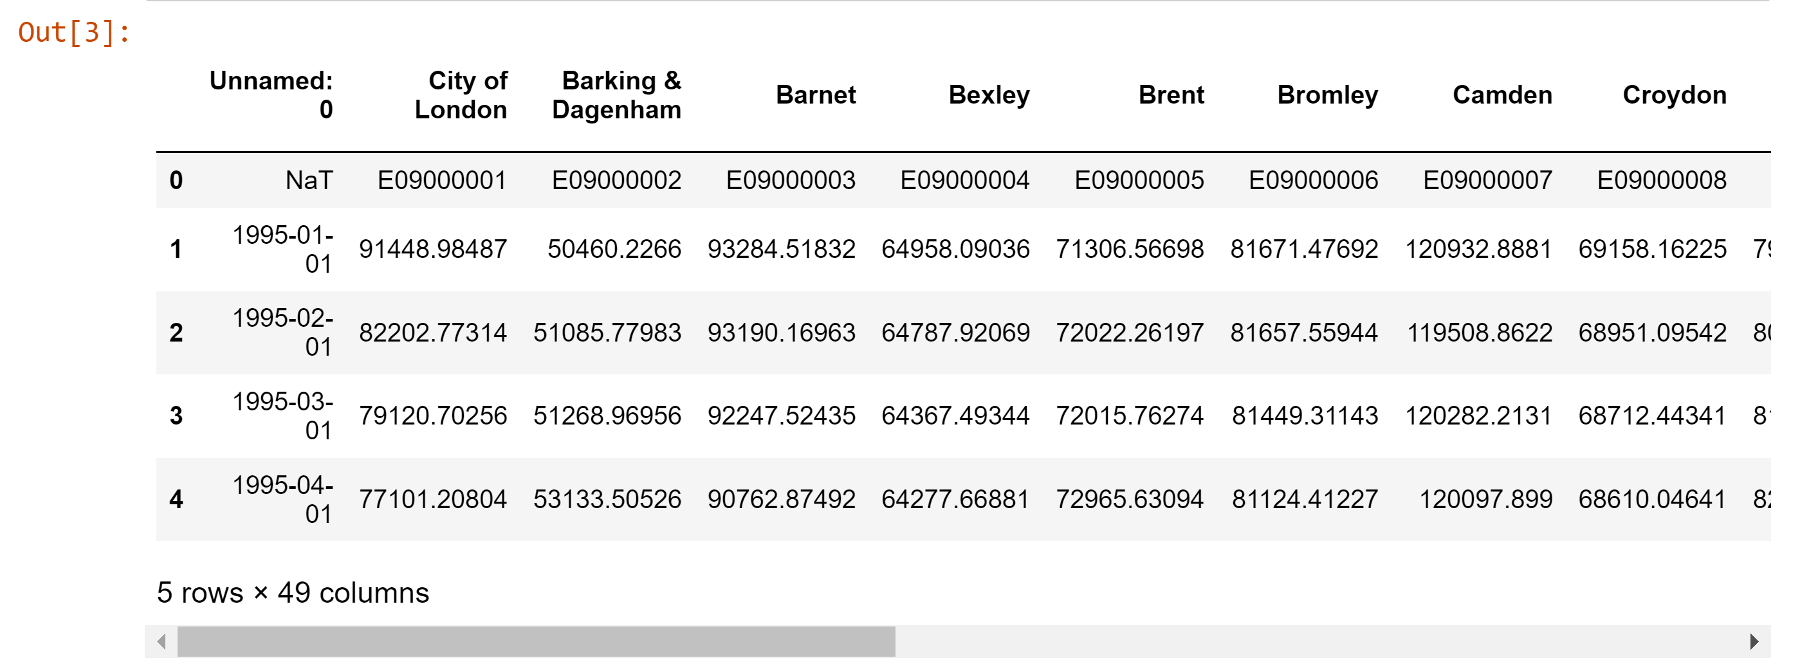
2. Cleaning, transforming, and visualizing
2.1. Exploring the data

Slide 5
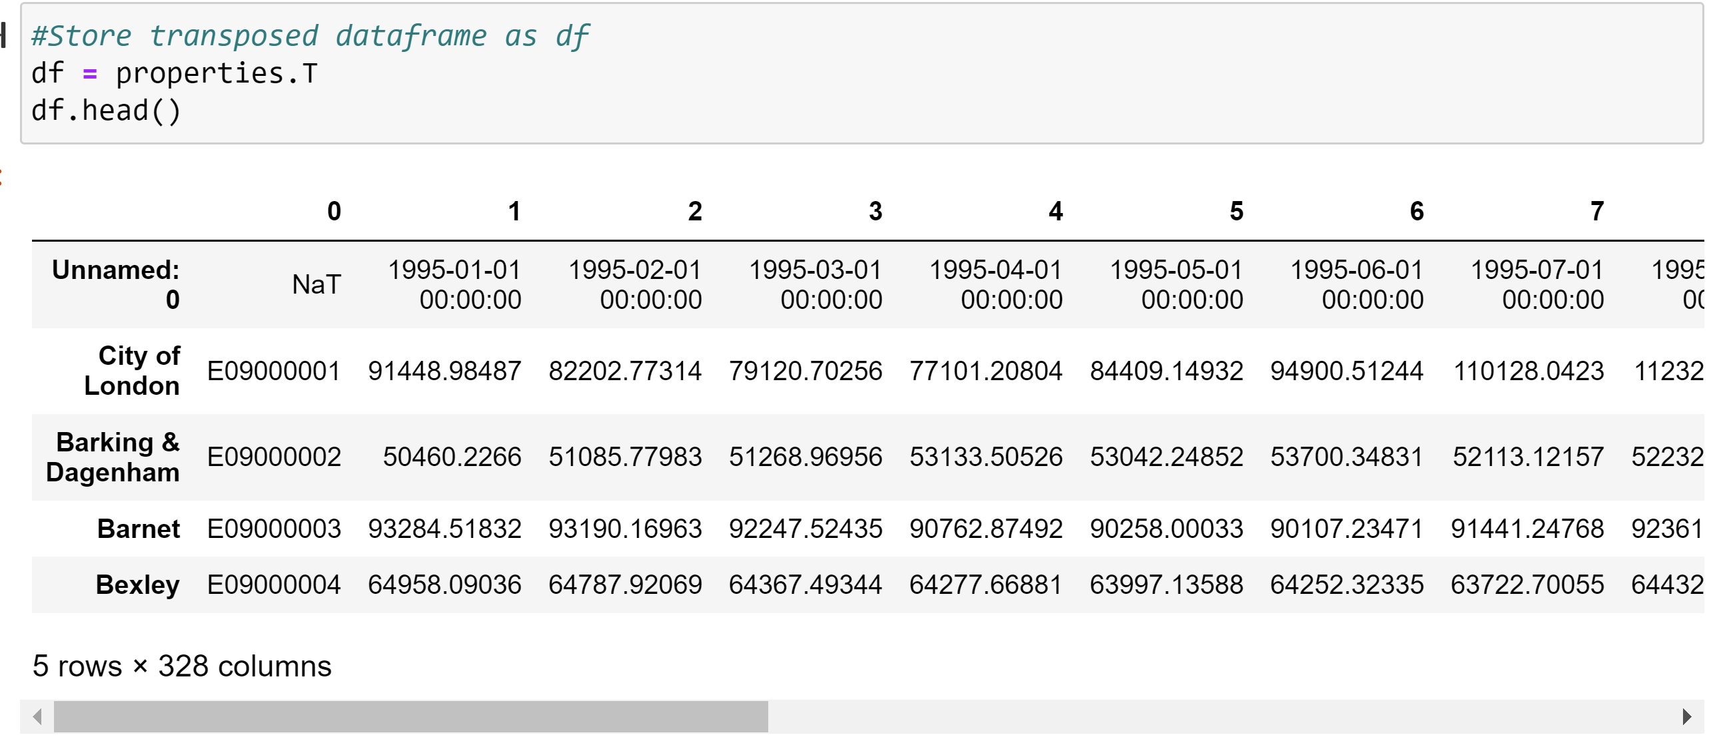
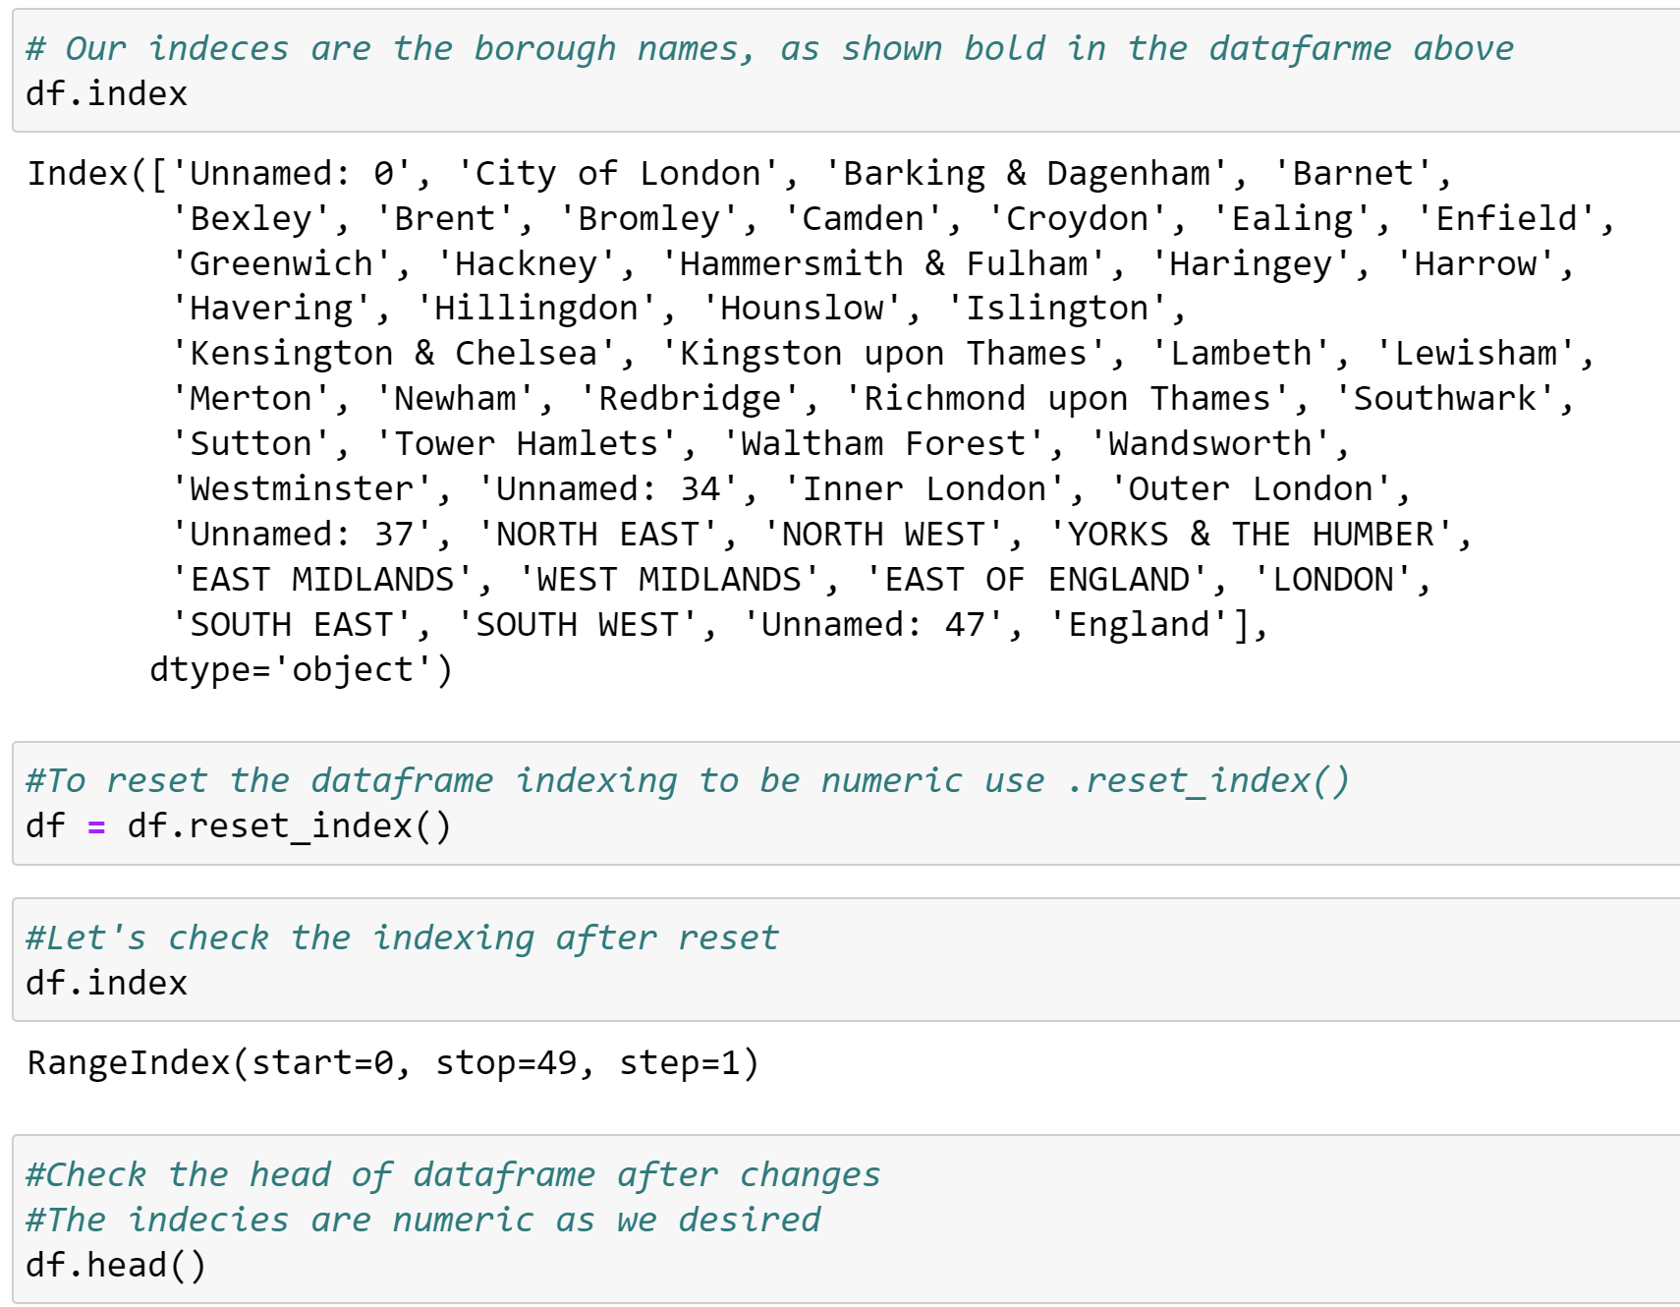
2. Cleaning, transforming, and visualizing
2.2. Cleaning the data
Store transformed dataframe
Reset index

Slide 6
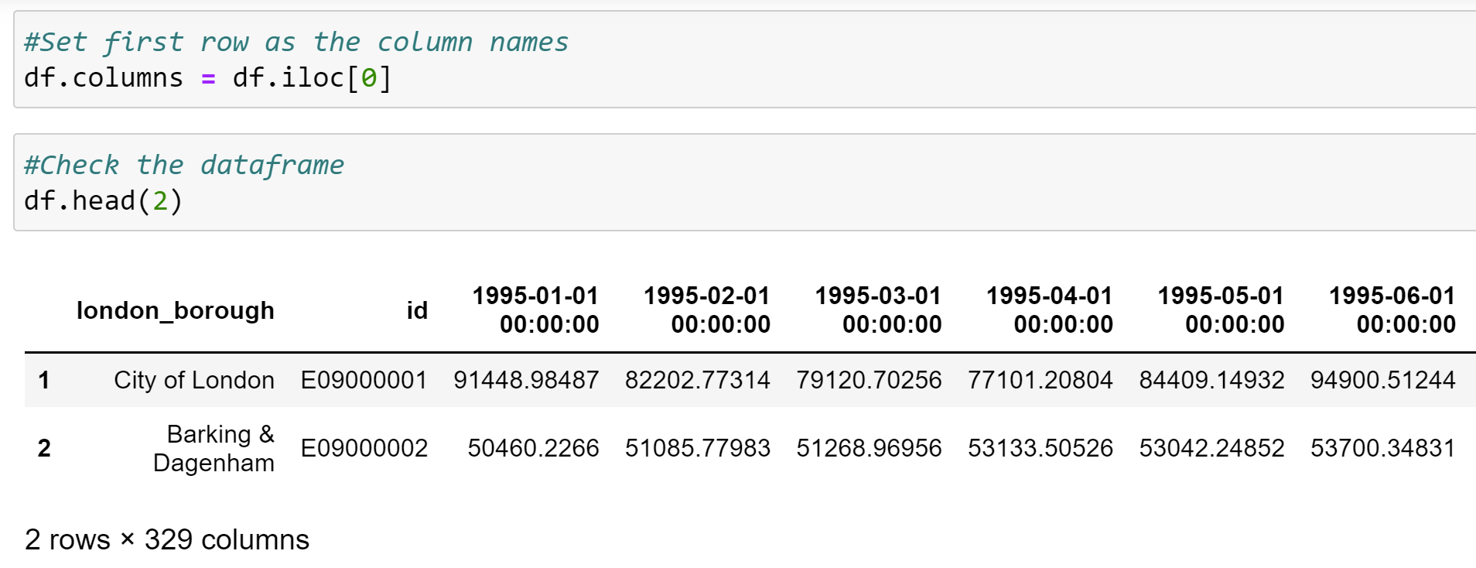
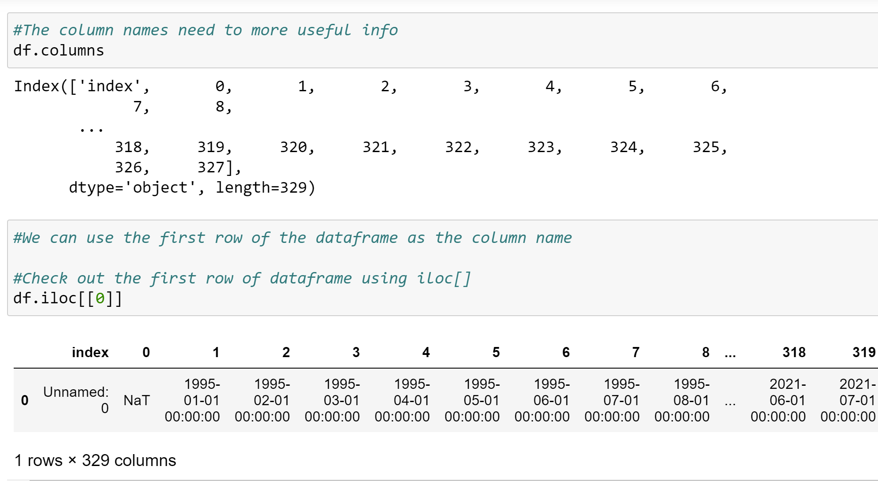
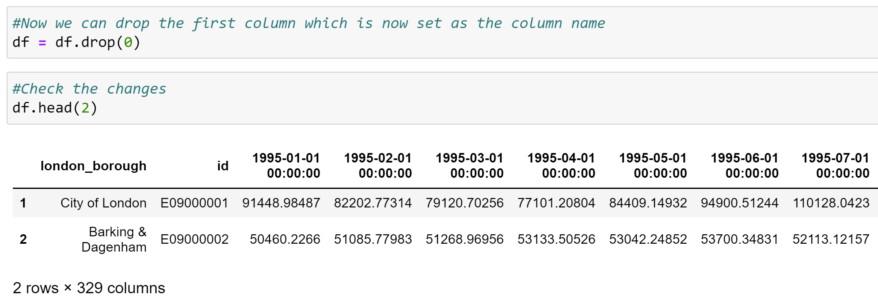
2. Cleaning, transforming, and visualizing
2.2. Cleaning the data
Set the column names

Slide 7
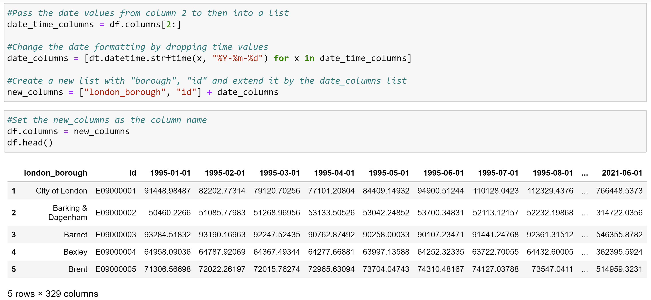
2. Cleaning, transforming, and visualizing
2.3. Cleaning the data (part 2)
Rename column name and format the date values

Slide 8
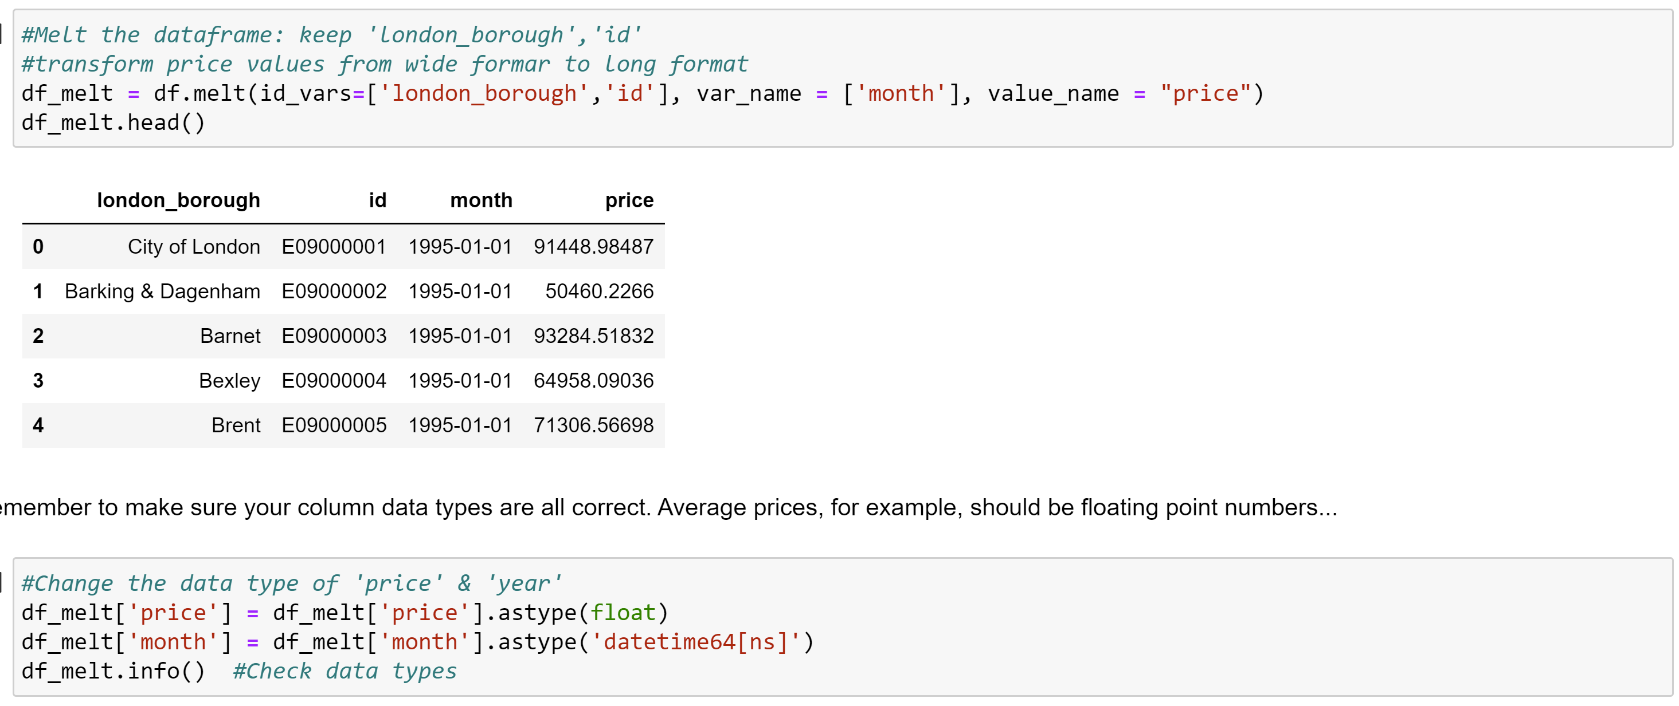
2. Cleaning, transforming, and visualizing
2.4.Transforming the data

Slide 9
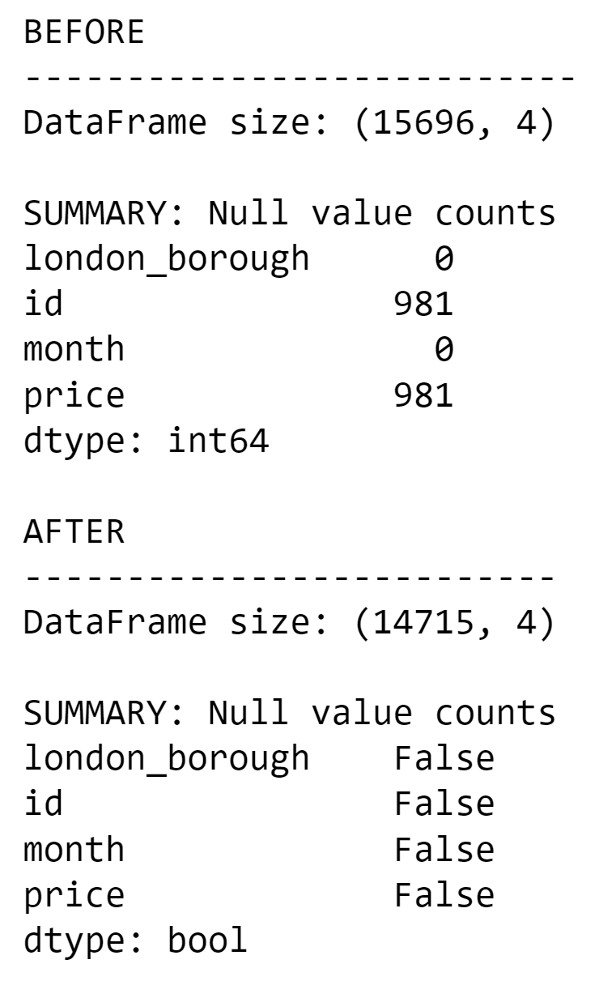
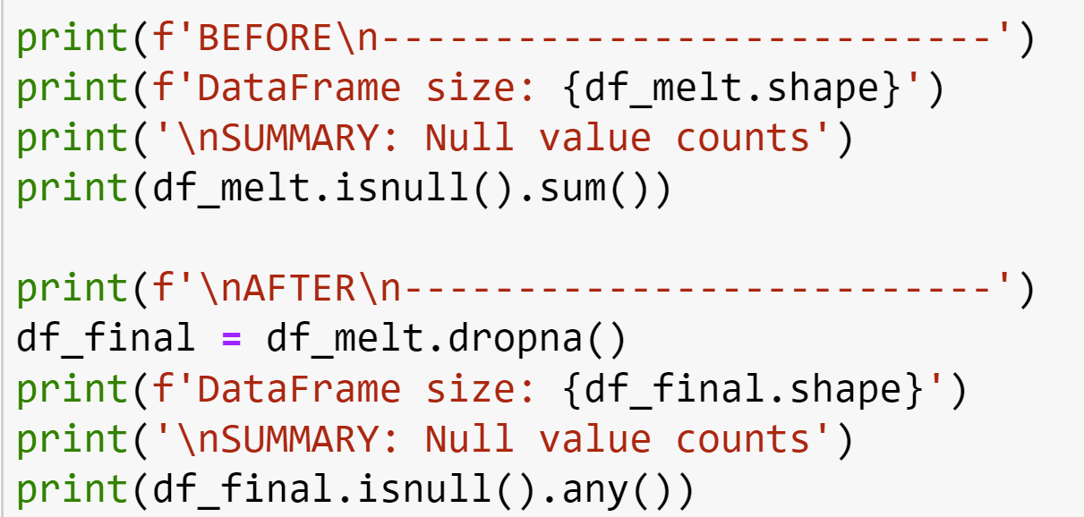
2. Cleaning, transforming, and visualizing
2.5. Cleaning the data (part 3)
Remove null values

Slide 10
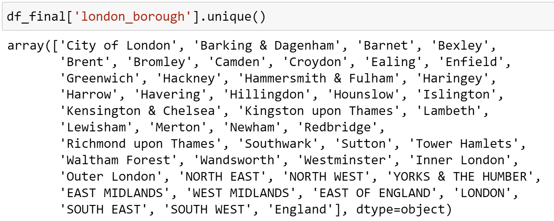
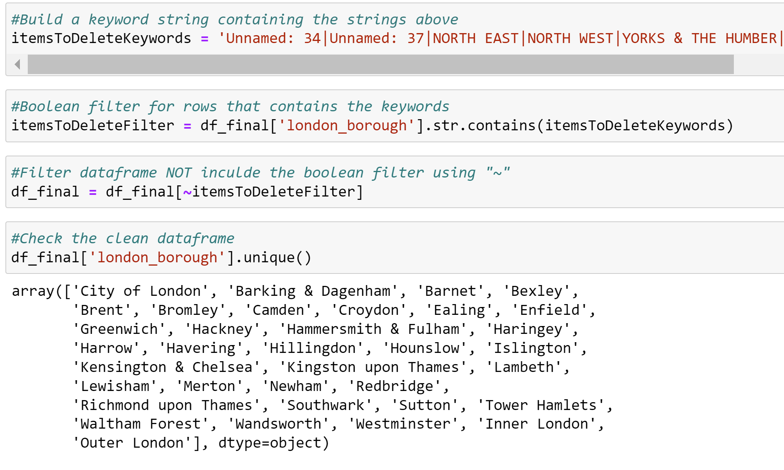
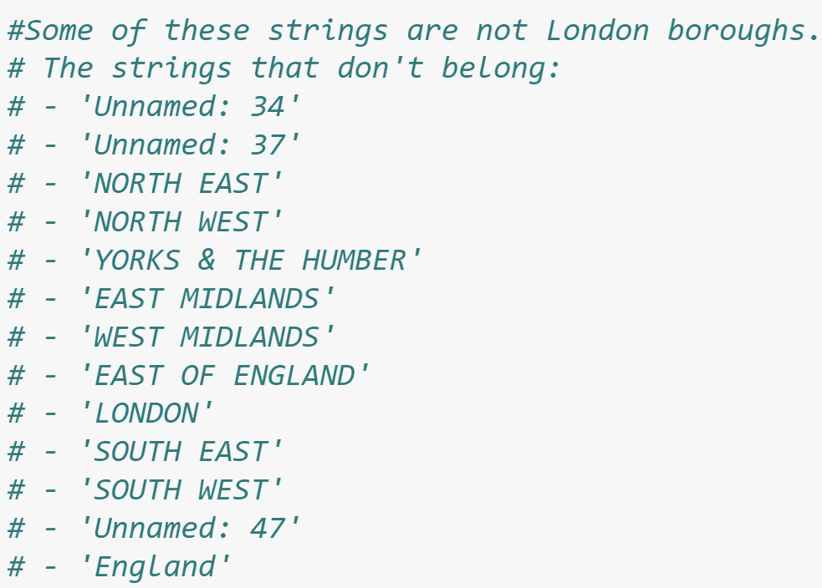
2. Cleaning, transforming, and visualizing
2.5. Cleaning the data (part 3)
Remove rows related to non-boroughs

Slide 11
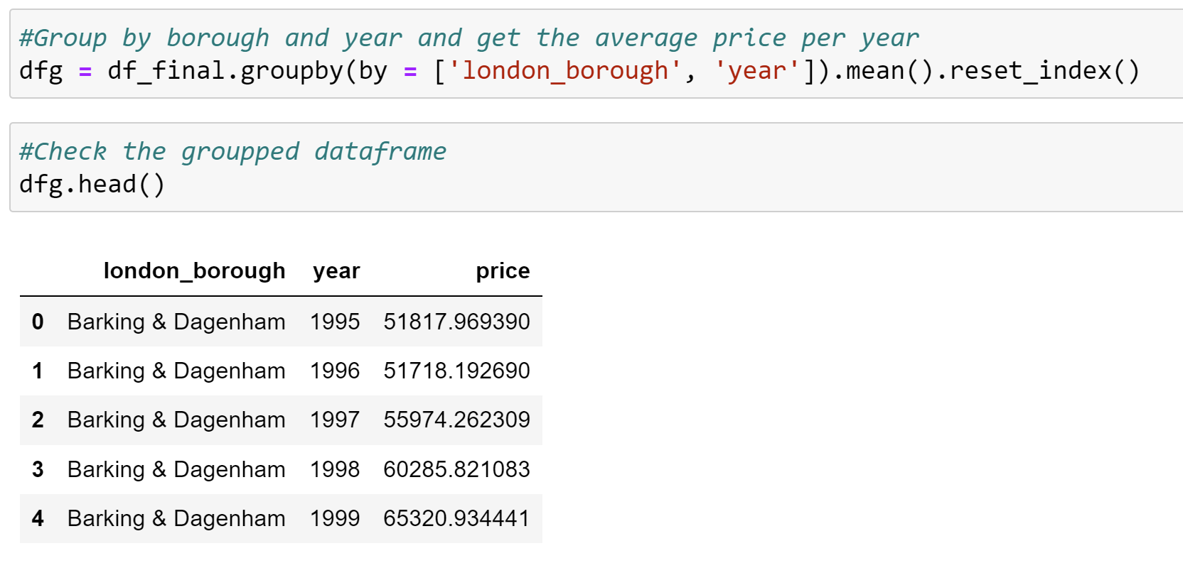
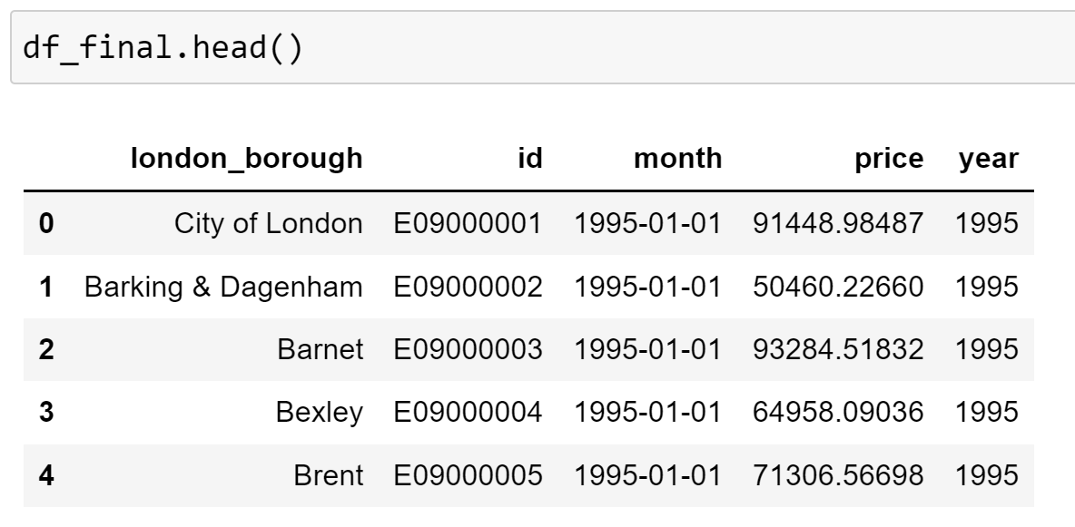
2. Cleaning, transforming, and visualizing
2.6. Visualizing the data

Slide 12
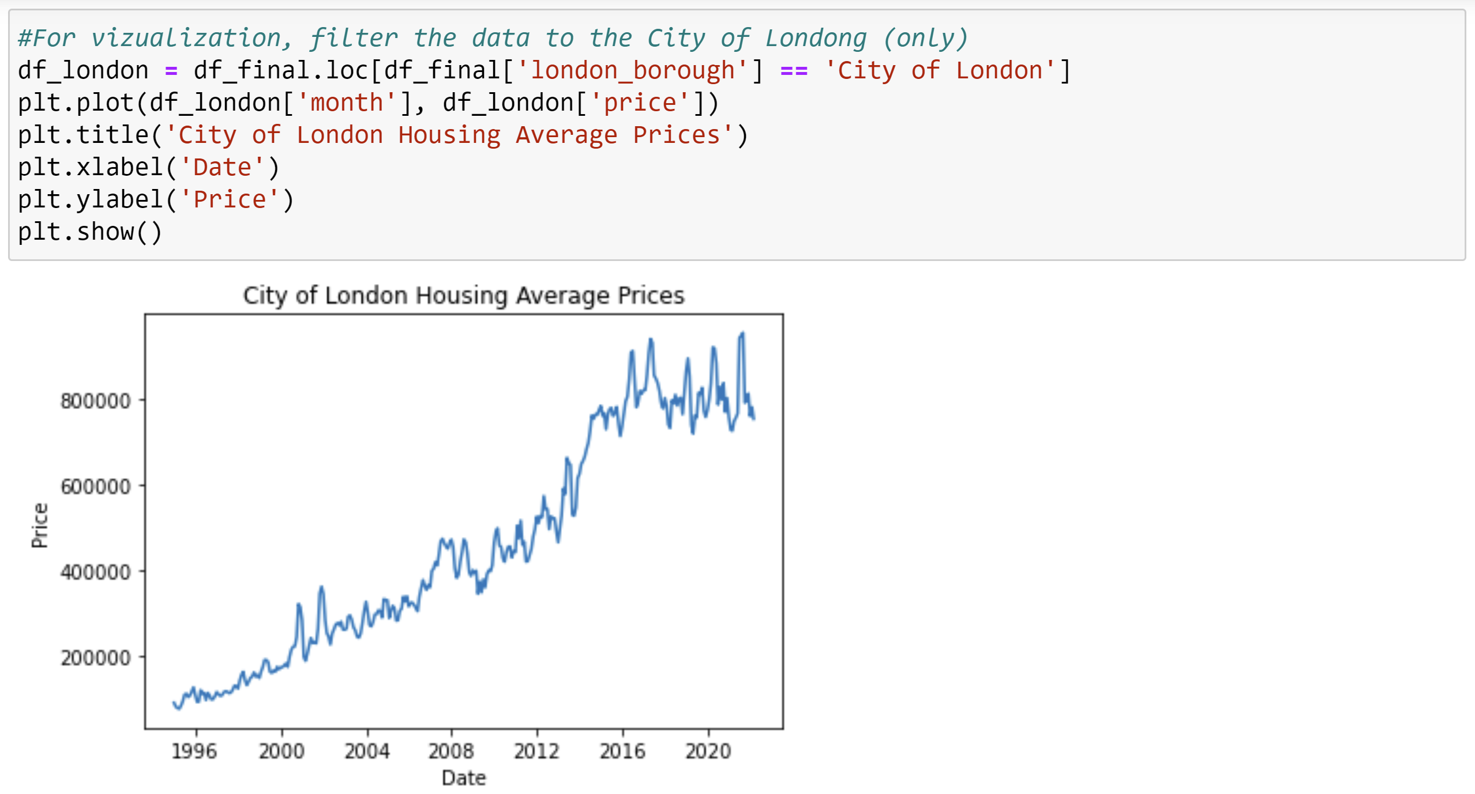
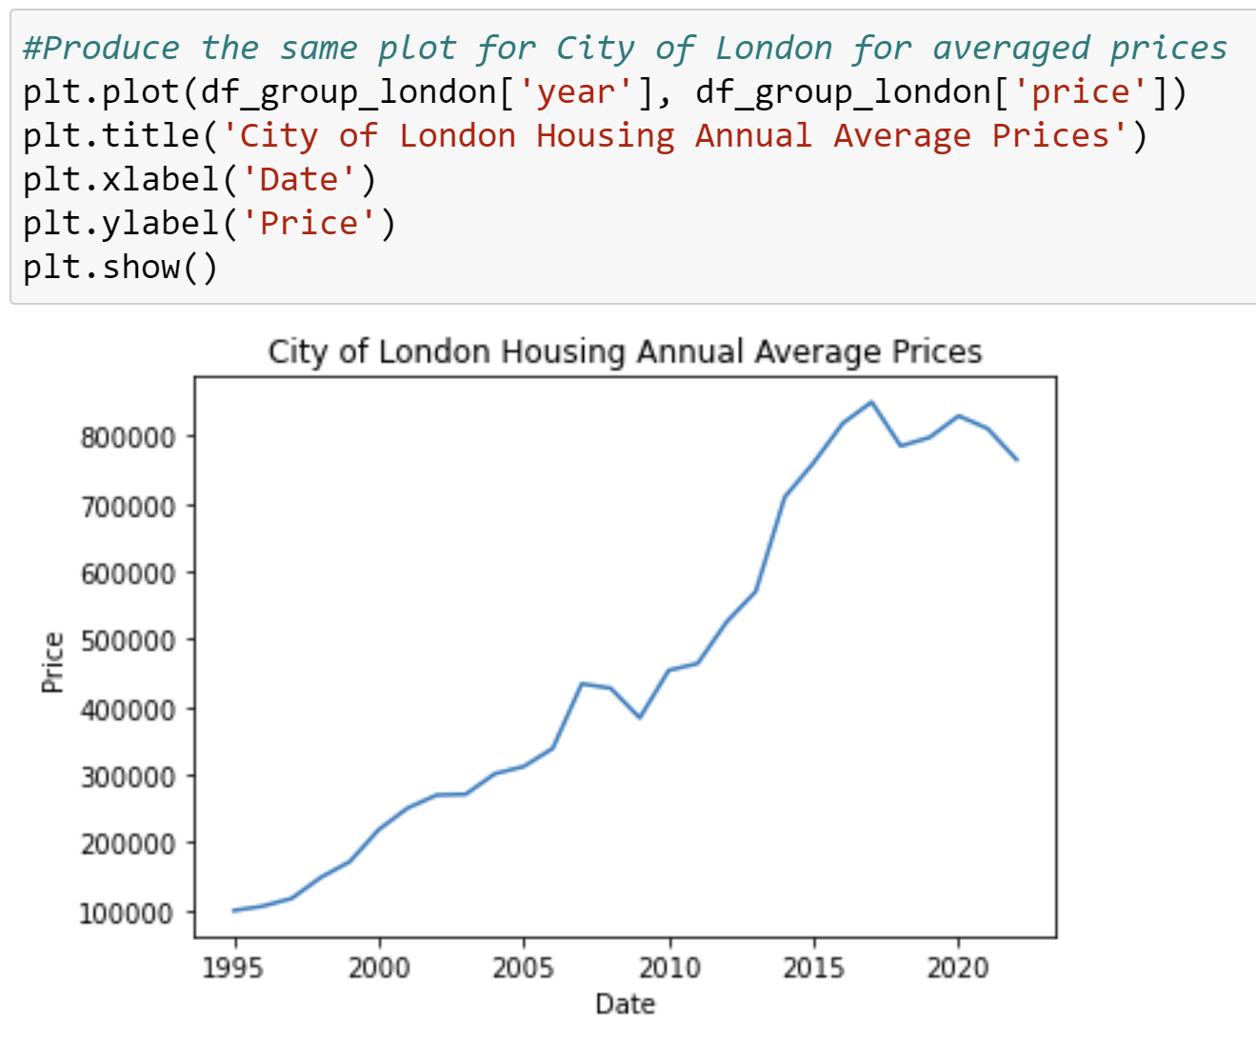
2. Cleaning, transforming, and visualizing
2.6. Visualizing the data

Slide 13
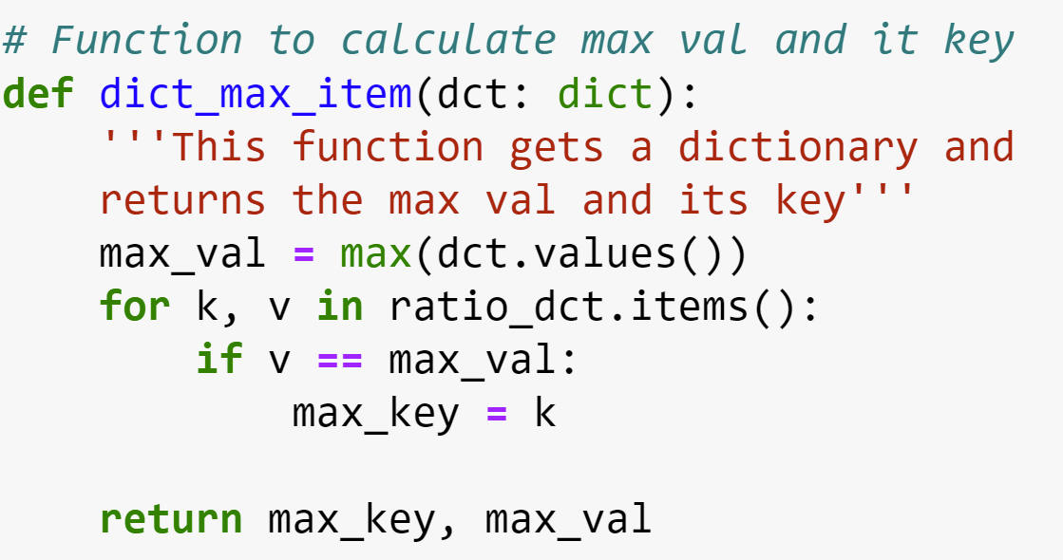
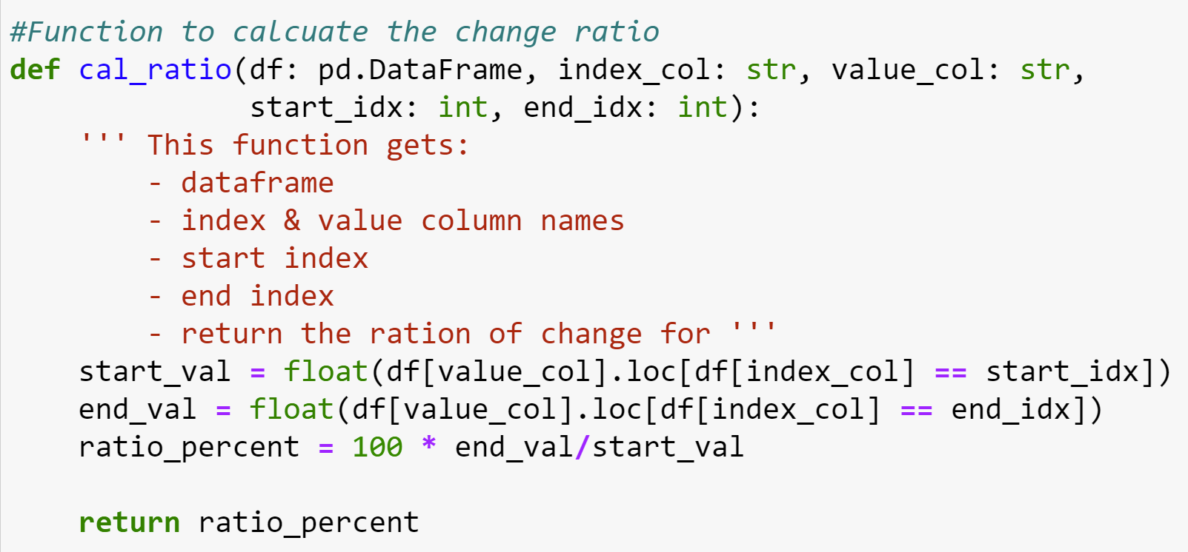
3. Modeling
Calculate max value and key
Calculate annual average
Calculate change ratio

Slide 14
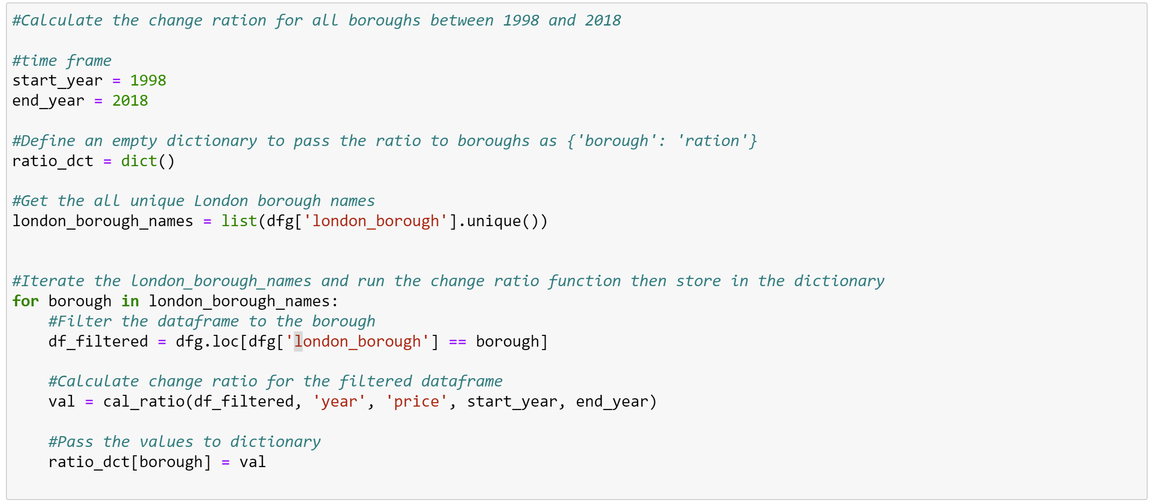
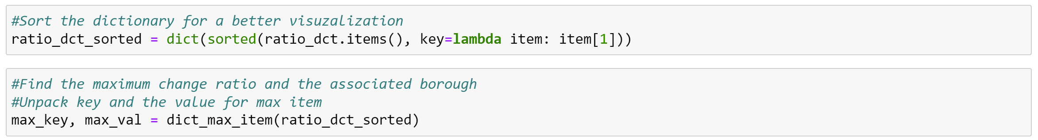
3. Modeling
Calculate the change ration for all boroughs between 1998 and 2018

Slide 15
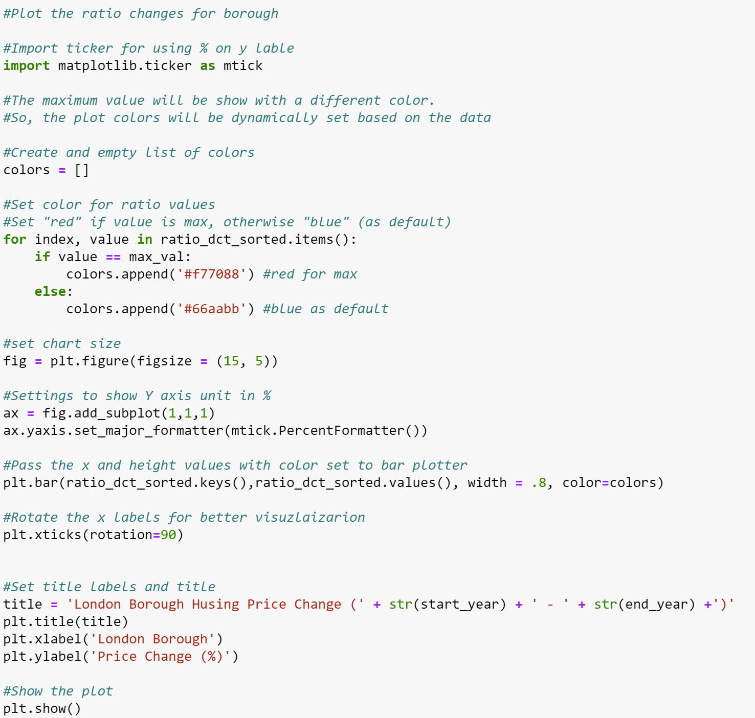
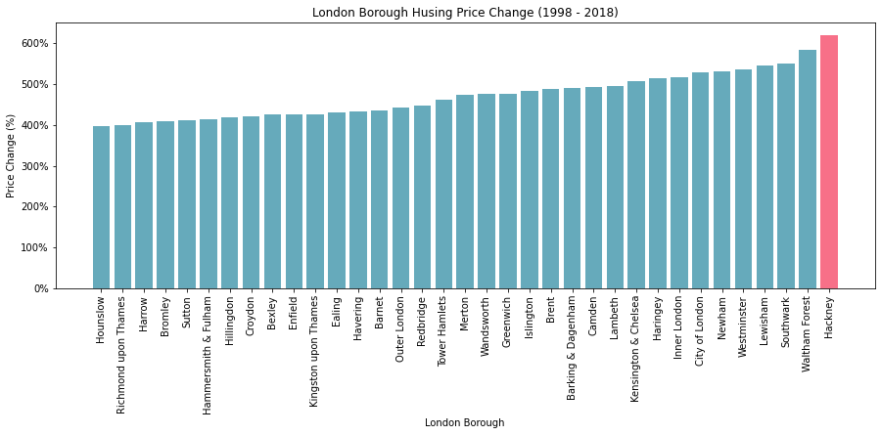
3. Modeling
Plot the ratio and highlight the borough with biggest ration change

Slide 16
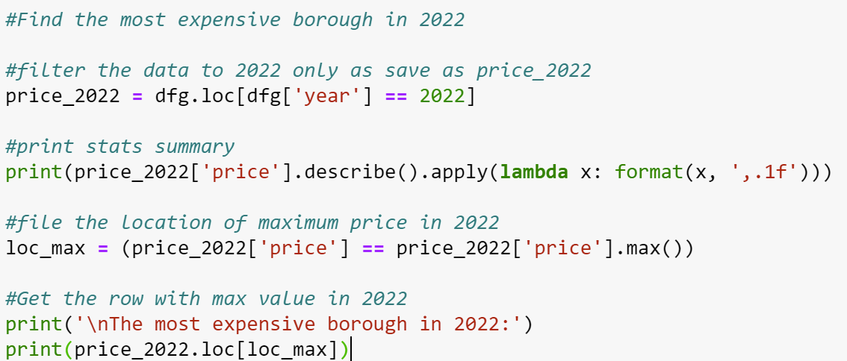
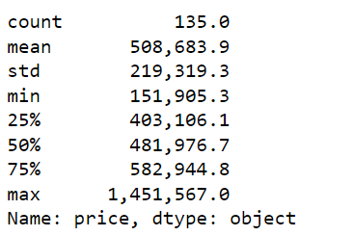
3. Modeling
Find the most expensive borough in 2022

Slide 17
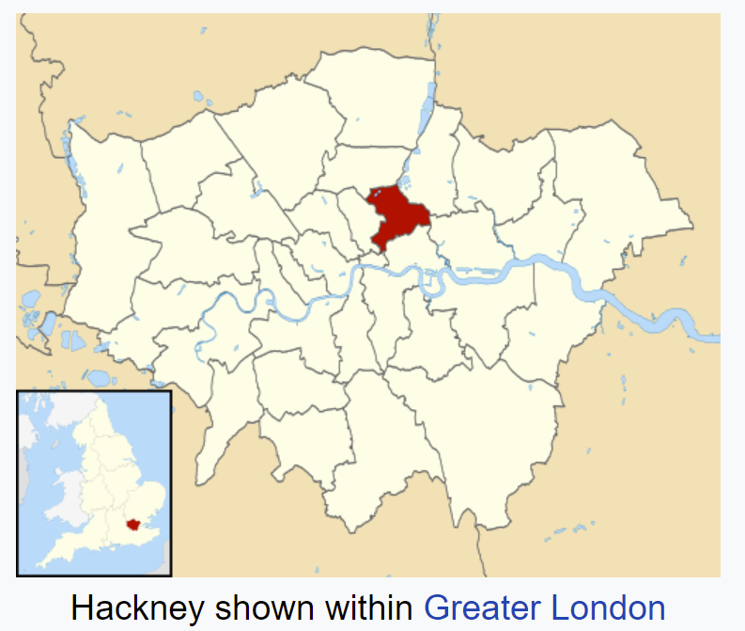
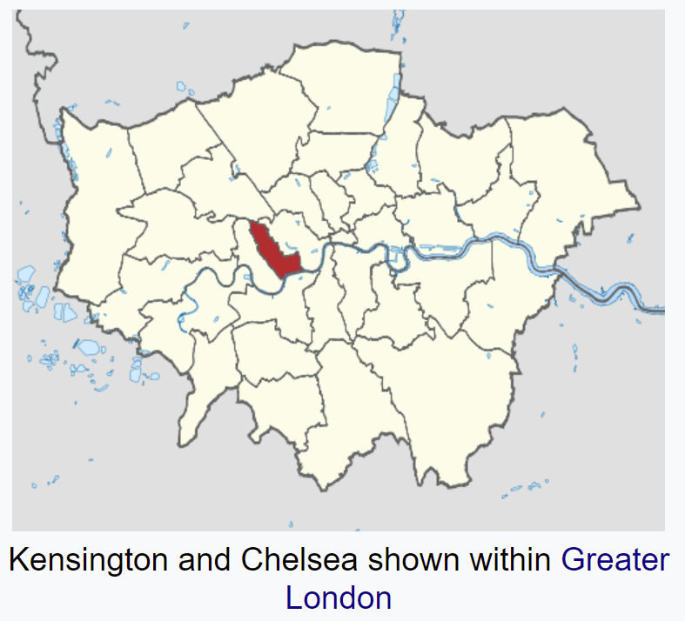
4. Conclusion
Largest housing price
Most expensive in 2022
Hackney borough has the largest housing price change between the years 1998 and 2018.
The average house price has changed by 620 % in this time frame in this borough.
Kensington & Chelsea with an average price of 1,451,567 was the most expensive London borough in 2022.

